Slide 1



Design Specification for Stack Data Structure

Slide 2
introduce
Data structures are fundamental components in computer science that enable efficient data management and manipulation. Among various data structures, the stack stands out due to its simplicity and utility in various applications, particularly in managing function calls and maintaining execution context in programming.
A stack is a linear data structure that follows the Last In, First Out (LIFO) principle, meaning the last element added to the stack is the first one to be removed. This characteristic makes stacks ideal for scenarios where you need to track operations in a specific order, such as in function call management, expression evaluation, and backtracking algorithms.
In this design specification, we will explore the memory stack in detail, including its operations, implementation, and significance in function calls within a computer system. We will outline the operations that can be performed on a stack, such as push, pop, and peek, and discuss their input parameters, pre- and post-conditions, as well as their time and space complexity. Additionally, we will delve into how stacks are utilized to manage function calls, demonstrating the concept of stack frames and highlighting the importance of stacks in programming languages.
By the end of this document, you will gain a comprehensive understanding of stacks, their operations, and their critical role in computer programming and memory management.

Slide 3
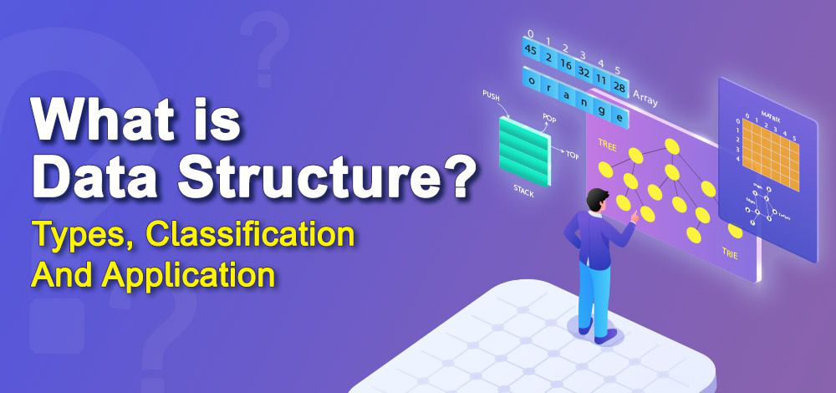
Identify the Data Structures
A data structure is a storage that is used to store and organize data. It is a way of arranging data on a computer so that it can be accessed and updated efficiently.
A data structure is not only used for organizing the data. It is also used for processing, retrieving, and storing data. Different basic and advanced types of data structures are used in almost every program or software system that has been developed. So we must have good knowledge of data structures

Slide 4
Define the Operations
The primary operations of a memory stack include:
Push: Adds an item to the top of the stack.
Pop: Removes the item from the top of the stack.
Peek (or Top): Returns the item on the top of the stack without removing it.
IsEmpty: Checks if the stack is empty.
Size: Returns the number of items currently in the stack.

Slide 5
Specify Input Parameters
A data structure is a storage that is used to store and organize data. It is a way of arranging data on a computer so that it can be accessed and updated efficiently.
A data structure is not only used for organizing the data. It is also used for processing, retrieving, and storing data. Different basic and advanced types of data structures are used in almost every program or software system that has been developed. So we must have good knowledge of data structures

Slide 6
Define Pre- and Post-conditions
Pre-conditions are conditions that must be true before a function is executed, while post-conditions are the expected outcomes after the function has run.
Example:
For the factorial function:
Pre-condition:
n must be a non-negative integer (i.e., n >= 0).
Post-condition:
The function returns an integer that is the product of all positive integers up to n.
If n is 0, the function returns 1 (since 0! = 1).

Slide 7
Discuss Time and Space Complexity
Time and space complexity are measures of the efficiency of an algorithm.
Time Complexity: Describes how the runtime of an algorithm increases relative to the input size.
For the factorial function (using recursion), the time complexity is O(n) because it makes n recursive calls.
Space Complexity: Describes how the memory usage of an algorithm increases relative to the input size.
For the recursive factorial function, the space complexity is also O(n) due to the call stack used by recursion.

Slide 8
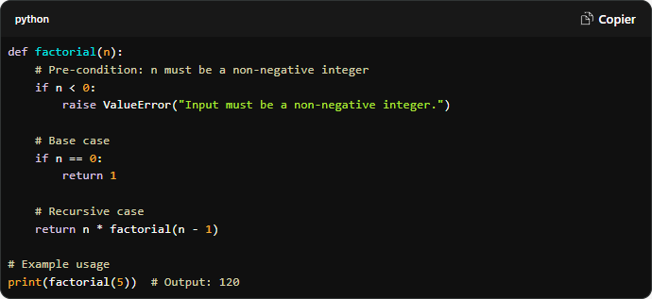
Provide Examples and Code Snippets (if applicable)

Slide 9
Determine the operations of a memory stack and how it is used to implement function

Slide 10
Identify Operations
The primary operations of a memory stack include:
Push: Adds an item to the top of the stack.
Pop: Removes the item from the top of the stack.
Peek (or Top): Returns the item on the top of the stack without removing it.
IsEmpty: Checks if the stack is empty.
Size: Returns the number of items currently in the stack.

Slide 11
Function Call Implementation

Slide 12
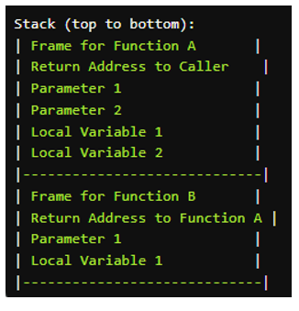
Demonstrate Stack Frames
Each function call creates a stack frame, which contains:
Return Address: Where to return after the function completes.
Function Parameters: Input data for the function.
Local Variables: Variables that are local to the function.
Saved Registers: Any registers that need to be preserved across function calls.

Slide 13
Discuss the Importance
The memory stack is crucial for several reasons:
Function Management: It provides a systematic way to manage function calls and returns.
Local Variable Storage: Local variables are stored in a way that they are automatically cleaned up when a function exits.
Recursion Support: The stack enables recursive function calls, allowing functions to call themselves.
Efficient Memory Use: Stack memory is typically faster to allocate and deallocate compared to heap memory.
Control Flow: It maintains the order of function calls, ensuring that each function returns to the correct place in the code.
Discuss the Importance of Sorting Algorithms
Sorting algorithms play a crucial role in computer science and programming for several reasons:

Slide 14
Discuss the Importance
1. Efficiency in Data Organization
Accessibility: Sorted data is easier to search through. For example, binary search, which operates in O(log n) time, can only be performed on sorted data. This dramatically improves search efficiency compared to linear search (O(n)).
Data Retrieval: Many applications require data to be presented in a specific order (e.g., alphabetical, numerical). Sorting algorithms help achieve this efficiently.
2. Foundation for Other Algorithms
Sorting is often a preliminary step for more complex algorithms. For instance, many algorithms in computational geometry, machine learning (like k-nearest neighbors), and data analysis rely on sorted data for optimal performance.
Some algorithms, like merge sort, are specifically designed to work with divide-and-conquer approaches, which are foundational to many data processing techniques.
3. Performance Considerations
Algorithm Choice: Understanding the time and space complexities of sorting algorithms helps developers choose the right algorithm based on the dataset size and structure. For instance:
QuickSort: Preferred for smaller datasets due to its in-place sorting and average-case efficiency.
MergeSort: Preferred for larger datasets or when stability is required, despite its higher space complexity.
Adaptability: Some algorithms perform better with specific types of data. For example, QuickSort can be optimized with good pivot selection strategies, while MergeSort excels with linked lists.

Slide 15
Conclusion
In summary, the stack data structure is a crucial element in computer science, providing an efficient means of managing data in a specific order through its Last In, First Out (LIFO) principle. We have explored the various operations that can be performed on a stack, including push, pop, peek, and checking for emptiness, each with defined input parameters and conditions for successful execution.
The stack's role in function call management is particularly noteworthy. By utilizing stack frames, the system can maintain the context of function calls, manage local variables, and ensure proper return addresses, which is essential for maintaining the flow of execution in programming. This functionality underscores the importance of stacks in various computational tasks, from simple algorithms to complex application logic.
Moreover, the comparison between stack implementations using arrays and linked lists reveals trade-offs in terms of space efficiency and ease of use, allowing developers to choose the most suitable implementation based on their specific needs.
Overall, the stack is not only a foundational data structure but also a powerful tool that enhances the efficiency and organization of programming tasks. Understanding its operations and applications is vital for any computer scientist or software developer aiming to write efficient and effective code. As we continue to build upon our knowledge of data structures, the stack will remain an integral part of our toolkit in solving complex problems and optimizing performance in software development.

Slide 16
1 Identify the Data Structures GeeksforGeeks (2022). What is Data Structure: Types, Classifications and Applications. [online] GeeksforGeeks. Available at: https://www.geeksforgeeks.org/what-is-data-structure-types-classifications-and-applications/. Define the stack GeeksforGeeks (2017). Introduction to Stack - Data Structure and Algorithm Tutorials. [online] GeeksforGeeks. Available at: https://www.geeksforgeeks.org/introduction-to-stack-data-structure-and-algorithm-tutorials/.
Reference

